Slide 1



UTHealth Houston - CPRIT Innovation in Cancer Prevention Research Training Program
Funded by Cancer Prevention and Research Institute of Texas (CPRIT)
INFORMATION SESSION
DOCTORAL & POSTDOCTORAL FELLOWSHIPS
Notes:
I’m Pat Dolan Mullen, Professor of Health Promotion and Behavioral Sciences at the School of Public Health, and I’m here with my colleagues Dr. Ross Shegog also from the School of Public Health; Dr. Sahiti Myneni, School of Biomedical informatics; and Dr. Natalie Sirisaengtaksin, the Graduate School of Biomedical Sciences to tell you about our cancer prevention training grant and answer your questions.
Our program has three major themes: One is innovative thinking--asking big questions, looking at problems in new ways;

Slide 2

Would you like to join outstanding scholars from diverse disciplines who are committed to a career advancing cancer prevention research?
Notes:
The second is transdisciplinary teamwork in which you are engaged with scholars from outside your primary field of study from 3 UTHealth Schools with placements at the McGovern Medical School, the Dental School, and UTHealth institutes.

Slide 3

Would you like to be a more innovative thinker?
Notes:
The third theme is health equity. We are funded by the Cancer Prevention Research Institute of Texas to close the gaps across ethnic/racial, gender, and socioeconomic groups to prevent cancer, detect it early, and control the side effects of cancer treatment.

Slide 4
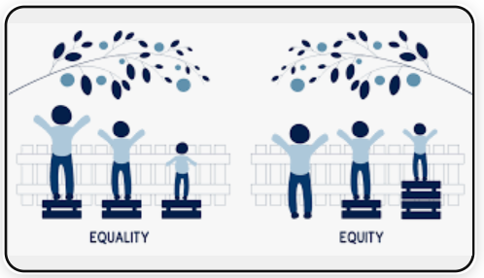
Would you like to close the gaps in cancer prevention and contribute to greater equity ?
Notes:
The third theme is health equity. We are funded by the Cancer Prevention Research Institute of Texas to close the gaps across ethnic/racial, gender, and socioeconomic groups to prevent cancer, detect it early, and control the side effects of cancer treatment.

Slide 5

Definitions
Primary Prevention: Measures that prevent the onset of illness before the disease process begins - through vaccinations, altering risky behaviors (e.g., poor eating. habits, tobacco use, sedentary living), and reducing environmental, occupational, and product exposures (e.g., ultraviolet radiation, tobacco, pesticides, viruses and bacteria)
Secondary Prevention: Measures that lead to early detection and prompt treatment of cancer or precancerous processes while localized disease (e.g., screening for breast, cervical, and colorectal cancer)
Tertiary prevention/Survivorship: Measures aim to soften the impact of common consequences of cancer and cancer treatment for the person with cancer and others (e.g., prevention of lymphedema, coordination of care, support for mental, physical. And financial well-being)

Slide 6
Examples
Public health informatics
Economic & policy analysis
Epidemiology & genetics
Cancer disparities & community Engagement
Data science & novel informatics approaches
Digital health technologies
Human factors engineering
EHR optimization
Intervention design, implementation, and scale-up
Biomarker discovery
Cancer genomics
Entrepreneurial technology
Notes:
We welcome applicants with a wide range of interests, talents, and career aspirations.

Slide 7
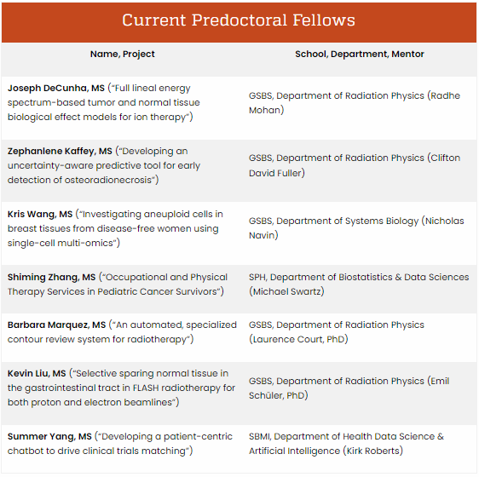
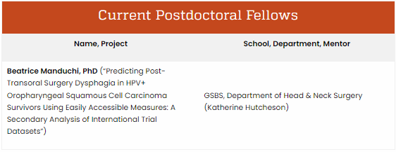
go.uth.edu/innovation

Slide 8
Individuals who were first in their family to attend college, have faced financial hardship, or were underserved are encouraged to apply.
Enrolled in a School Public Health doctoral program (any campus/any department) or the McWilliams School of Biomedical Informatics, McGovern Medical School or Graduate School of Biomedical Sciences (any department)
DOCTORAL
ELIGIBILITY
International visa holders are welcome to apply.

Slide 9
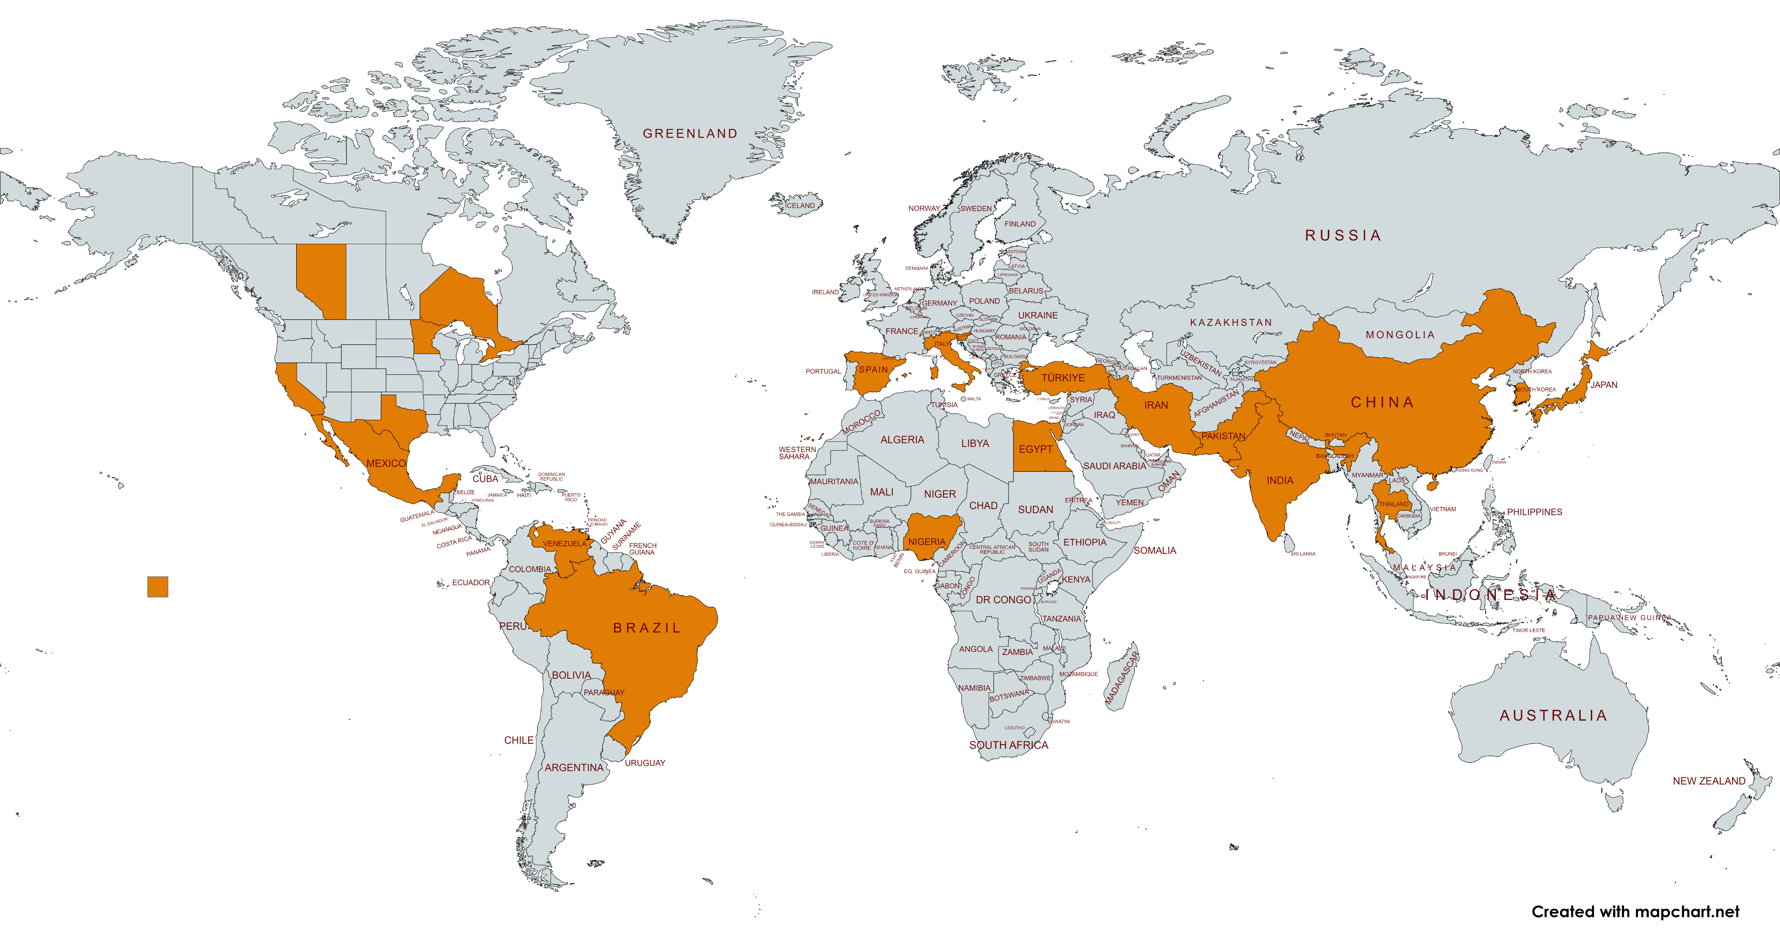

Slide 10
TRANS-DISCIPLINARY
SEMINAR, CROSS-TRAINING, INNOVATION TOOLS
TUITION & FEES
DOCTORAL
PROGRAM
BENEFITS
STIPEND* + STUDENT HEALTH INSURANCE
BOOKS, SOFTWARE, & LAPTOP
UP TO 3 YEARS OF SUPPORT
WRITING & COMMUNICATION
TRAINING
TRAVEL
CPRIT requires mentors to pay research expenses

Slide 12
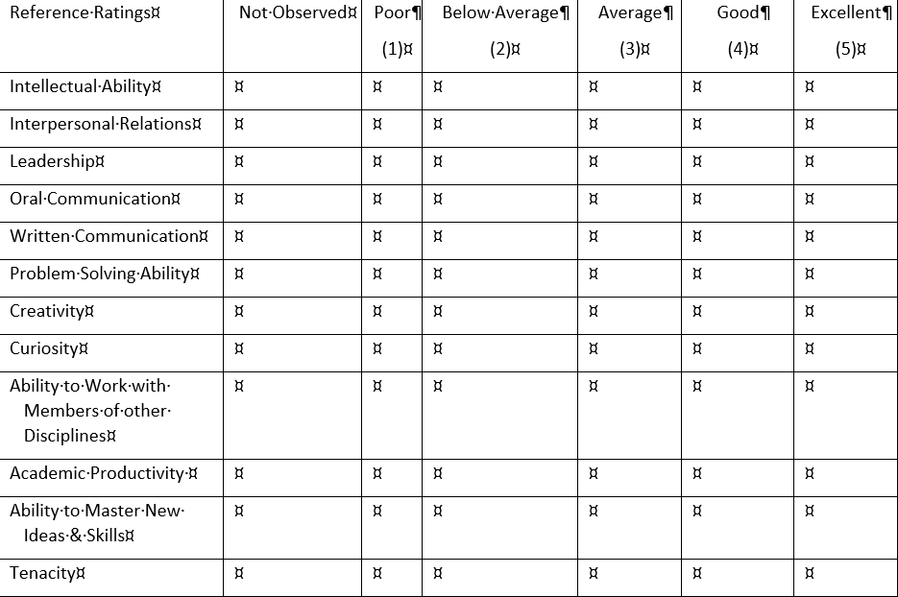

Slide 13
Individuals who were first in their family to attend college, have faced financial hardship, or were underserved are encouraged to apply.
Working in (or selected for) a School Public Health lab/research project (any campus/any department) or the McWilliams School of Biomedical Informatics, Dentistry, or the McGovern Medical School*
POSTDOC
ELIGIBILITY
International visa holders are welcome to apply
*

Slide 14
TRANS-DISCIPLINARY
SEMINAR, CROSS-TRAINING, INNOVATION TOOLS
TUITION & FEES
POSTDOC
PROGRAM
BENEFITS
NRSA LEVEL STIPEND, starting at $61,008 + STUDENT HEALTH INSURANCE
BOOKS, SOFTWARE, & LAPTOP
2 YEARS OF SUPPORT
WRITING & COMMUNICATION
TRAINING
UTHEALTH HOUSTON POSTDOCTORAL CERTIFICATE
TRAVEL
CPRIT requires mentors to pay research expenses

Slide 15
Timeline
00
03
01
02
04
05
INFORMATION SESSIONS
SEPTEMBER
APPLICATIONS DUE
OCTOBER 10
Semi-Finalists INTERVIEWS and BRAINSTORMING SESSION
OCTOBER/NOVEMBER
Finalists INTERVIEWS
NOVEMBER
SELECTION
DECEMBER
APPOINTMENTSBEGIN
JANUARY 1, 2025

Slide 16

FIND OUT MORE
go.uth.edu/innovation
cpritfellowships@uth.tmc.edu
patricia.d.mullen@uth.tmc.edu (SPH)
daniel.harrington@uth.tmc.edu (GSBS)
sahiti.myneni@uth.tmc.edu (SBMI)

